Slide 1
Metadata
OLAC 2012-10-18??
Robert Olendorf & Zoe Chao

Slide 2
Outline
Metadata
Descriptive
Administrative
XML and RDF
MIA (metadata in action)
OAIPMH
Web search
Hands on exercise (METS)

Slide 3

The Problem
FIND
IDENTIFY
SELECT
OBTAIN
Notes:
In the FRBR Final report the committee identified these four primary use cases.
FIND Material based on the user’s search criteria
IDENTIFY the desired entity
SELECT the appropriate entity
OBTAIN gain access to the desired entity

Slide 4
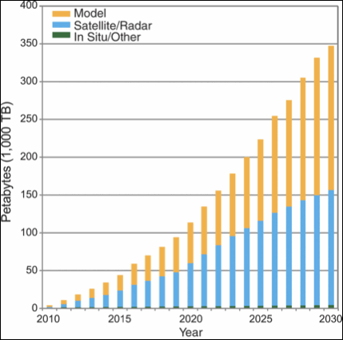
The Problem
FIND
IDENTIFY
SELECT
OBTAIN
Notes:
In the FRBR Final report the committee identified these four primary use cases.
FIND Material based on the user’s search criteria
IDENTIFY the desired entity
SELECT the appropriate entity
OBTAIN gain access to the desired entity

Slide 5
The Problem
Carmen – The Ballet
Carmen – The Score
Carmen – On Ice
Carmen – 1983 Movie
Notes:
The Ballet Carmen can be seen on video, in live performances. You can listen to the score. There is also Carmen On Ice and at least one move based on the ballet.

Slide 6
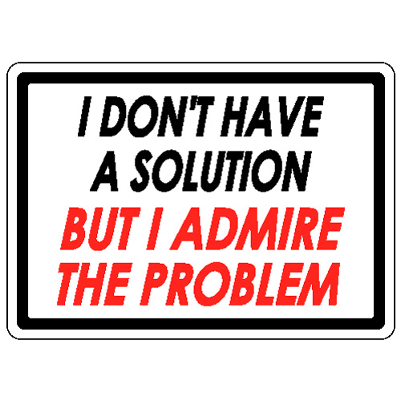
What Is Metadata
Metadata is in part a solution to these problems.

Slide 7
Function Requirement of Bibliographic Records
A Theory of Metadata

Slide 8
Works
Notes:
Work is a distinct intellectual creation – the concept of Carmen
Expression is a realization of that work – A ballet, the music, translations of a text
Manifestation is a physical embodiment – A companies version of the ballet, or an arrangement of the score. A movie.
Item – Deals with copies, such as individual CDs of the score.

Slide 9
Agents

Slide 10
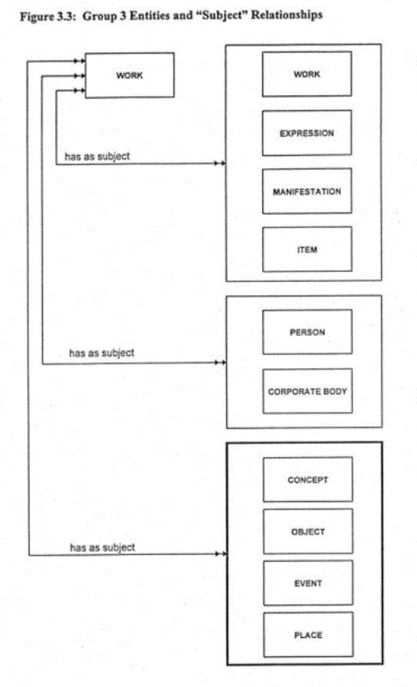
Subjects

Slide 11
What FRBR Buys Us
An explicit relationship between entities
A mechanism for determining what attributes are required
A common language
A framework for extension

Slide 13
What is metadata?
Content
How to structure
Syntax vs. Semantic

Slide 14
Metadata is essential in providing the means to describe, share, search, manage and preserve our digital resources, ensuring maximum potential for use and re-use throughout their lifecycle. The selection of metadata, and its management and administration, should be tailored to meet the specific needs of the collection and its various users, and follow established best practice, where it exists, within the community in which you are working. While metadata should be created focussing on the resource at hand, ideally some thought should also be made towards making it possible to share your data with other collections, catalogues and systems to maximise the potential use and re-use of resources.

Slide 15
What is metadata?
Does it have to be….
in XML?
in the Web environment?
machine readable?
for electronic resources only?

Slide 16
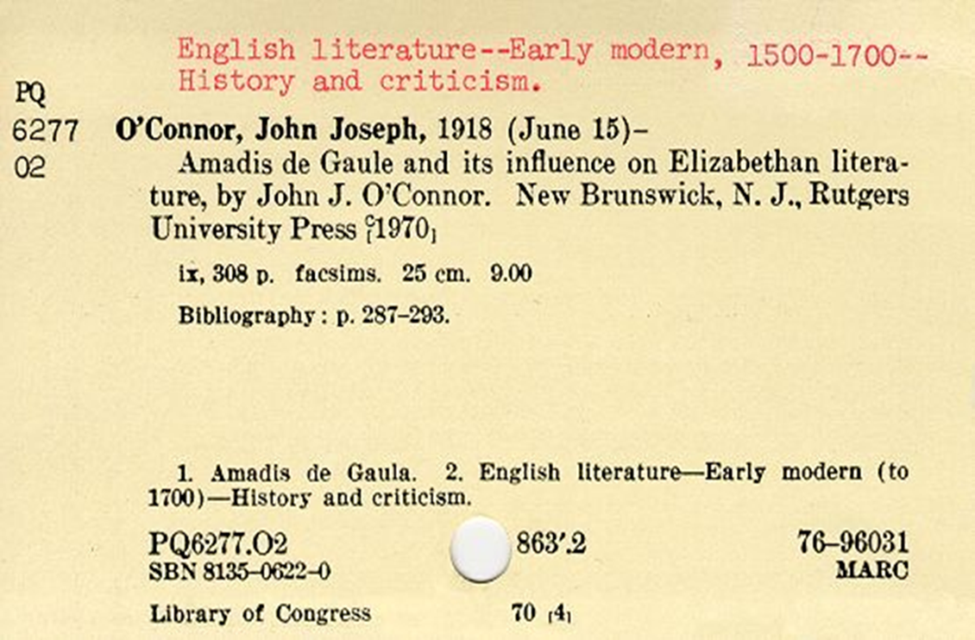
Is this metadata?

Slide 17
Metadata is…
data about data.
to impose some order in a disordered information universe. (Carl Lagoze)
constructed, constructive, and actionable. (Karen Coyle)

Slide 18
Metadata is…
“structured information that describes, explains, locates, or otherwise makes it easier to retrieve, use, or manage an information resource.”
NISO (2004). Understanding Metadata.
http://www.niso.org/standards/resources/UnderstandingMetadata.pdf
“structured, encoded data that describe characteristics of information-bearing entities to aid in the identification, discovery, assessment, and management of the described entities.”
ALA Committee on Cataloging: Description and Access

Slide 19
Boil down…
Structured data
Facilitate some types of actions
Find, identify, select, and obtain (FRBR)
Organization & management
The difference between data, metadata, and meta-metadata is often one of perspective. (Jenn Riley)

Slide 20

http://youtu.be/2wNTIPaBbPI

Slide 21
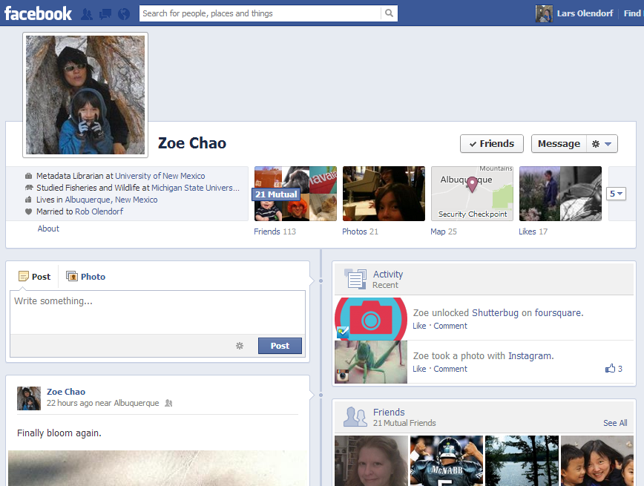

Slide 22
Types of Metadata
Descriptive metadata
identifies a resource and describes its intellectual content
title, author, keywords…
MARC, DC, EAD…
to find, access and manage

Slide 23
Technical metadata
focuses on how a digital object was created
format, identifier, date…
MIX, NISO Z39.87, TextMD…
Use: manage, access

Slide 24
Types of Metadata
Preservation / Provenance
contains information needed to archive and preserve a resource
OAIS, PREMIS
Rights
specifies intellectual property rights and permissions
CopyrightMD, Creative Commons
Structural
indicates how compound objects are put together, i.e. how pages are ordered to form chapters.
METS

Slide 25
Types of Metadata
Descriptive
Administrative
Technical
Intellectual Property Rights and Permissions
Digital Preservation / Provenance
Structural

Slide 26
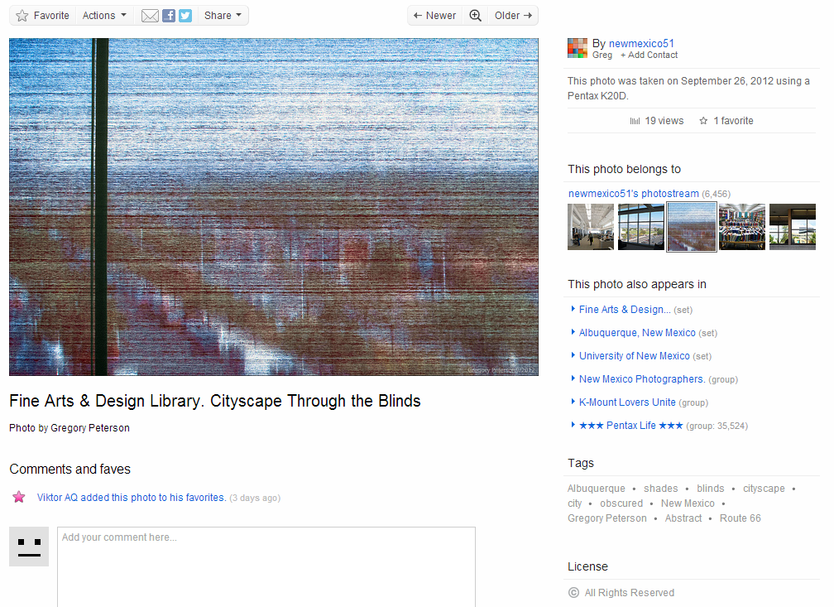
http://www.flickr.com/photos/8601342@N03/8031470074/in/photostream

Slide 27

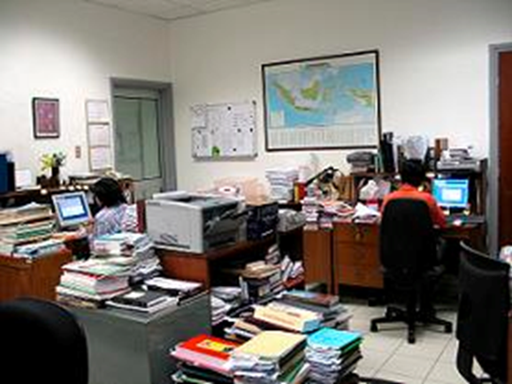
Who Creates Metadata?

Slide 28
Syntax vs. Semantic

Slide 29
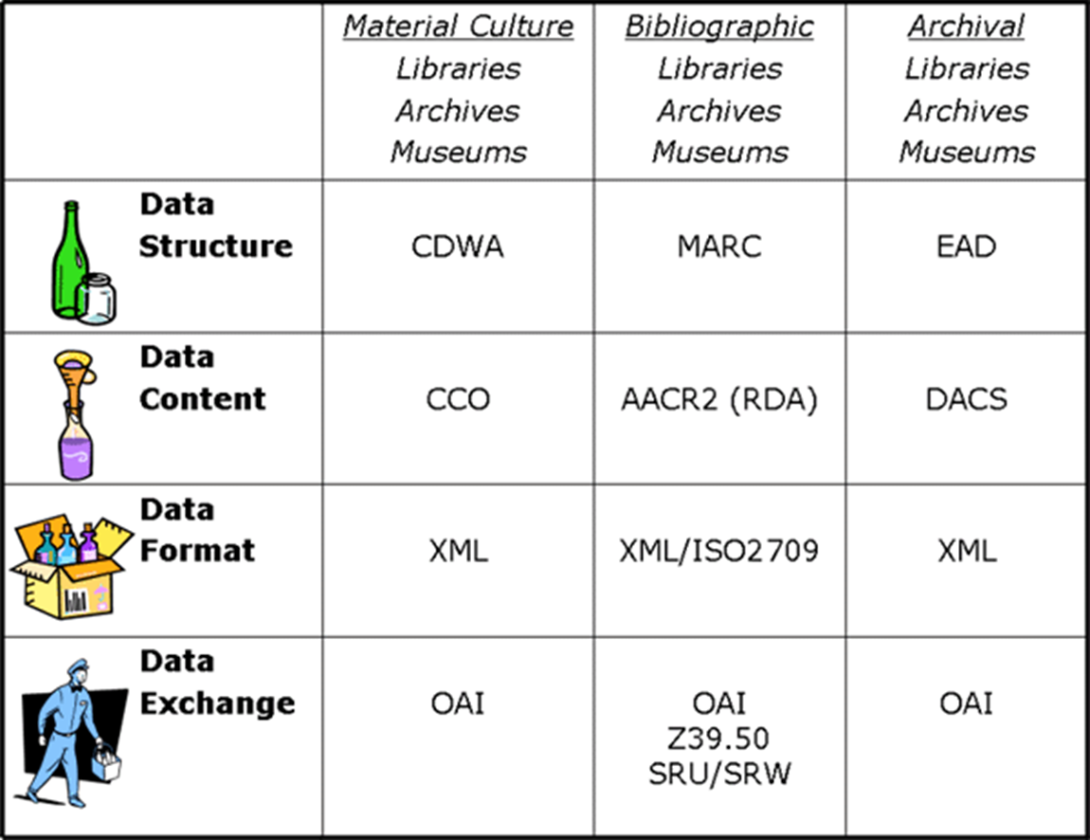
From “Metadata for All” by Elings & Waibel. <http://firstmonday.org/htbin/cgiwrap/bin/ojs/index.php/fm/article/view/1628/1543>
Notes:
CCO: cataloging cultural objects

Slide 30
How to structure?
Syntax: XML
Semantic: Metadata scheme
Semantic: Controlled vocabulary

Slide 31
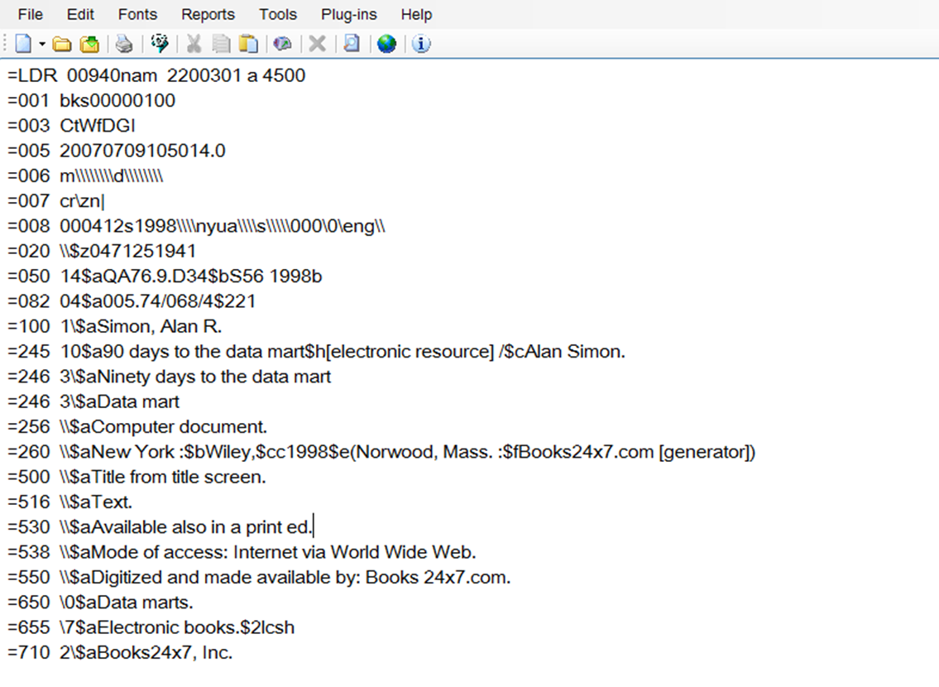
MARC

Slide 32
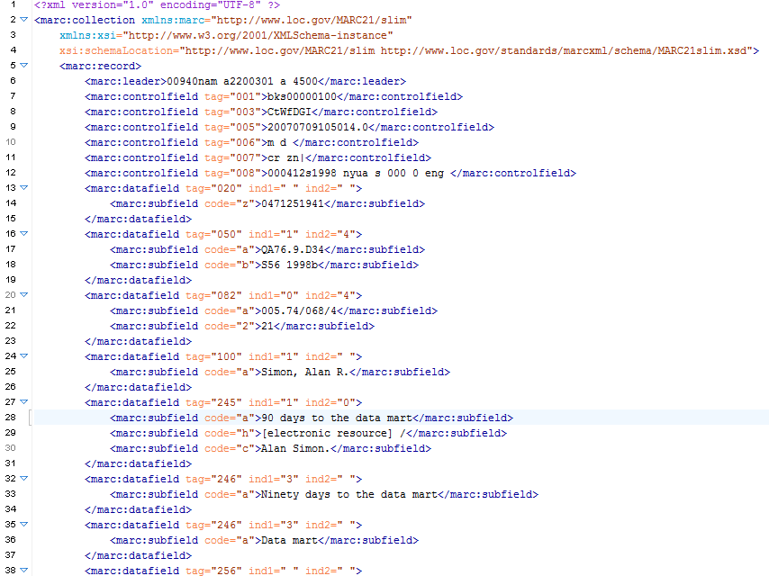

Slide 33
What is XML?
Why do we need markup?

Slide 34
Advantages of XML
Simple to understand and constructu
Universal
Both human and machine readable
Easy to transform

Slide 35
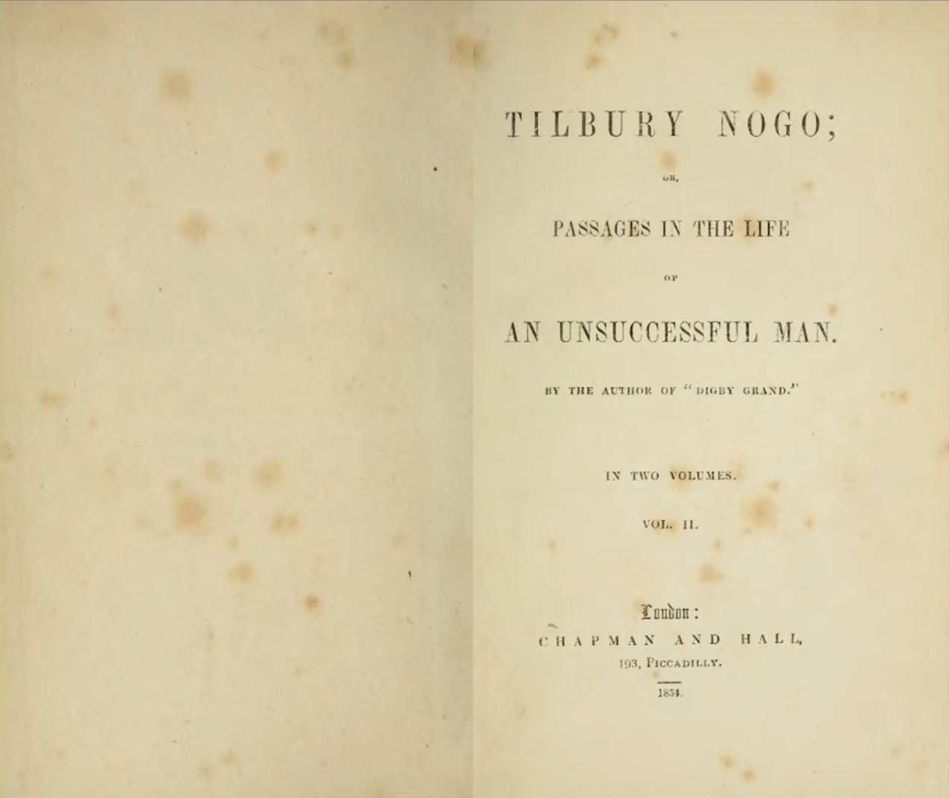

Slide 36
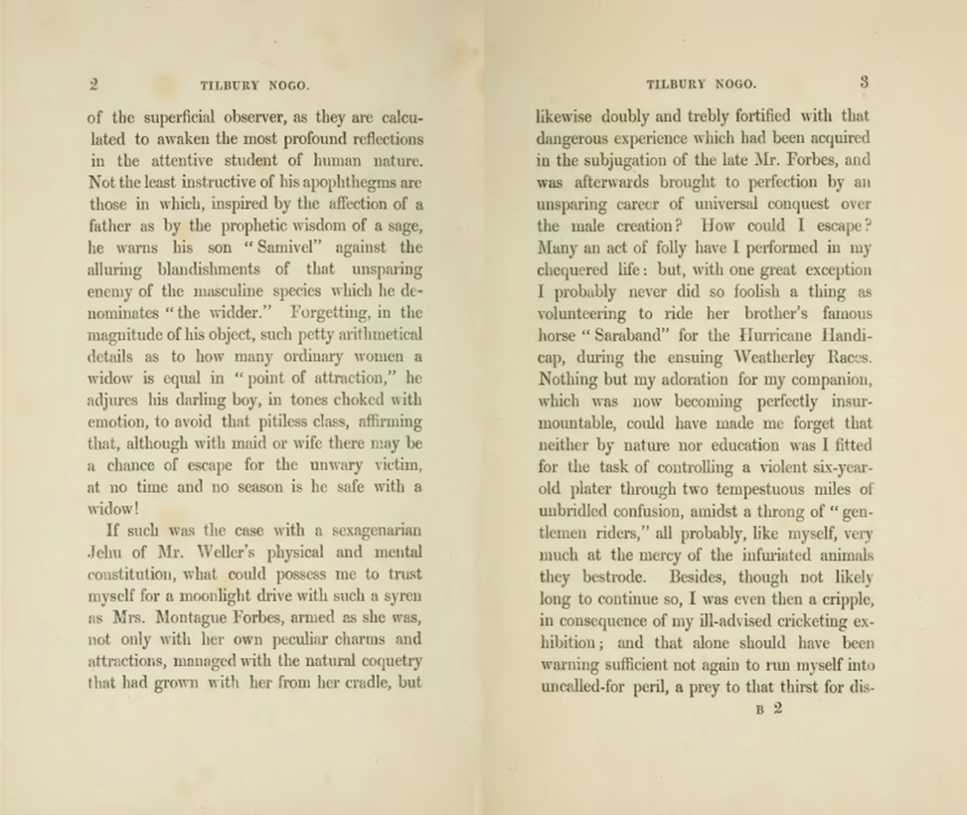

Slide 37
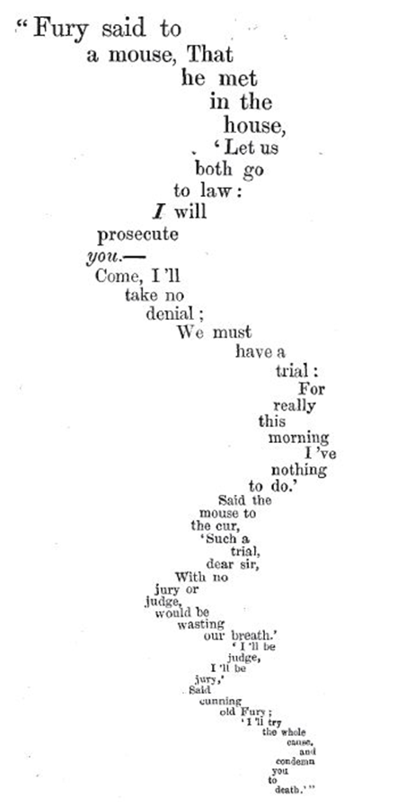
Lewis Carroll: The Mouse’s Tale

Slide 38
Syntax: how you say things
I love balloon fiesta!
Semantic: what it means
I love balloon fiesta!

Slide 40
What schema to use?
Simple schema (DC):
Complex schema
Application profile (mix and match)

Slide 41
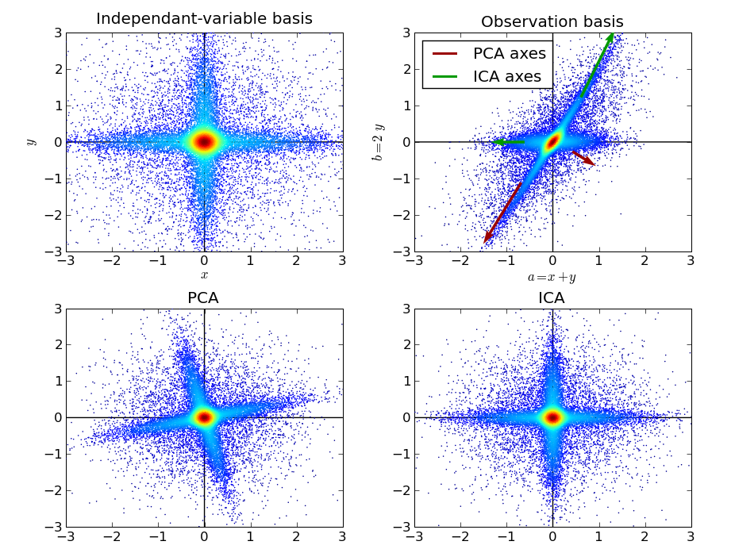
Another Problem

Slide 42
Hands on exercise

